Slide 1
Biweekly Meeting for RL Based Truck&Trailer Project
Jan 20th 2023

Slide 2
Recently Updates
Finish the randomly generation of training maps
Revise Reward function according to the change environment
Start working on Truck Trailer 3D model

Slide 3
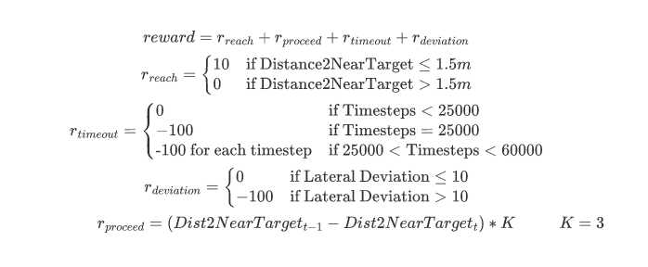
Reward function revision

Slide 4
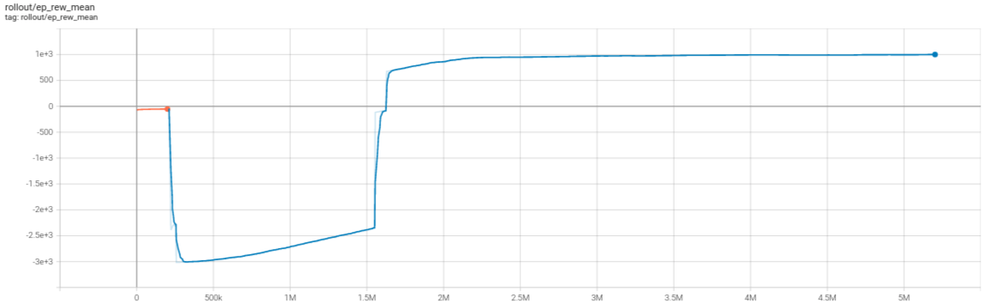
Training Results of 5 Random Maps
random5_0110.mp4 (sharepoint.com)

Slide 5
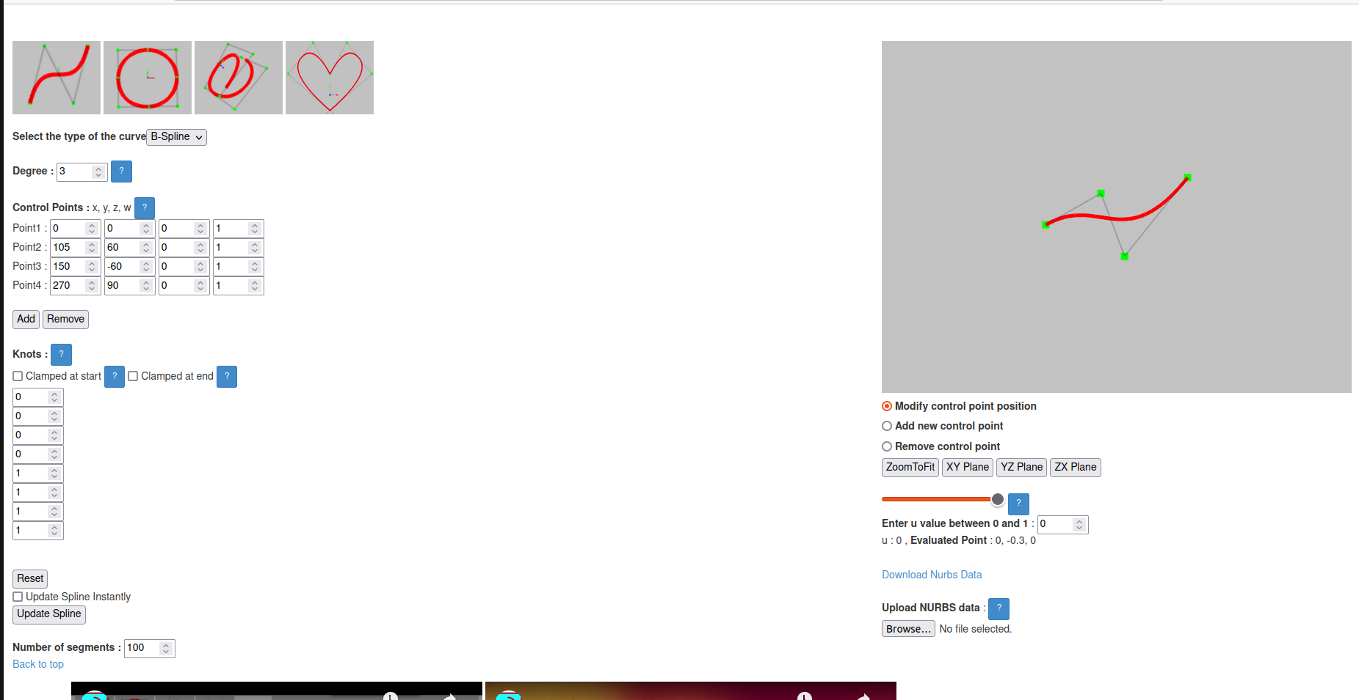
Random Map Generation
map_generation.mp4 (sharepoint.com)

Slide 6
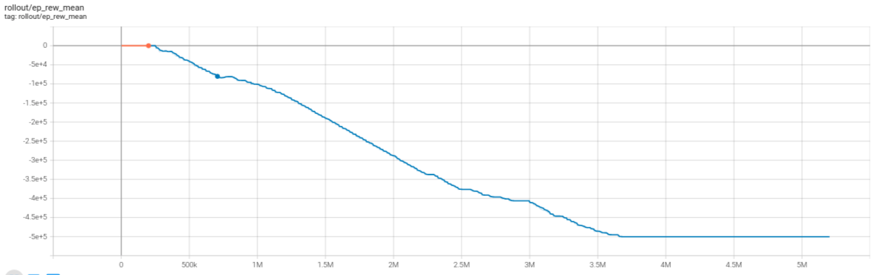
Training Results

Slide 7
Plans for next two week
Finish assembling truck model
Assign dynamic properties to the model
Put the model into training
Try with speed profile

